Slide 1
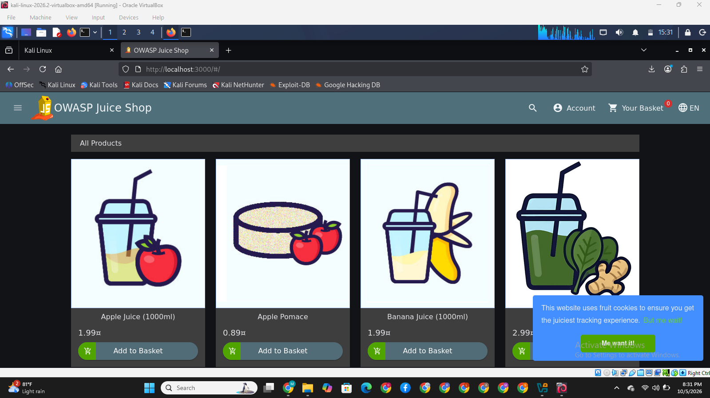
Attack Surface Mapping & Reconnaissance
OWASP Juice Shop (v17.1.1)
Reconnaissance, technology fingerprinting and attack surface mapping. No exploitation.
Prepared by Mercy Itunuoluwa Olalere
Notes:
Introduce the project: a reconnaissance-only assessment of a locally deployed OWASP Juice Shop v17.1.1. No exploitation was performed.

Slide 2
Assessment at a Glance
6
3
4
0
assets and endpoints inventoried
high-priority attack surfaces
stack layers fingerprinted
exploits run (recon only)
How the surface was mapped
Manual traversal and client-side JavaScript route inspection
Network traffic captured as a HAR archive to map backend routes
HTTP response headers and source inspection to fingerprint the stack
Notes:
Six assets made it into the inventory table; three are rated High. The work stayed strictly at recon level.

Slide 3
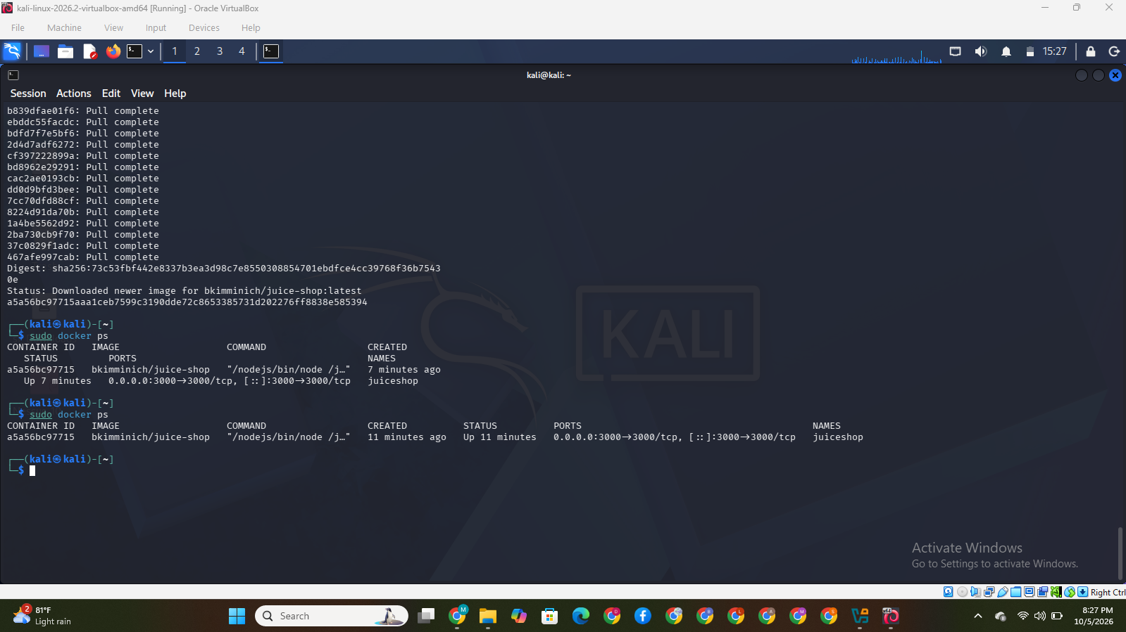
Environment Setup
1
Environment
Local virtual lab on Linux (Kali VM in VirtualBox), isolated from other networks
2
Deployment
Juice Shop v17.1.1 (Node.js) running locally in a Docker container, published on port 3000
3
Network binding
http://localhost:3000 (127.0.0.1)
4
Verification
Terminal: juiceshop container up, 0.0.0.0:3000 mapped to 3000/tcp
Web interface rendered and answered client HTTP GET requests
Notes:
The target runs locally so testing is isolated. The docker ps output shows the container up with port 3000 published.

Slide 4
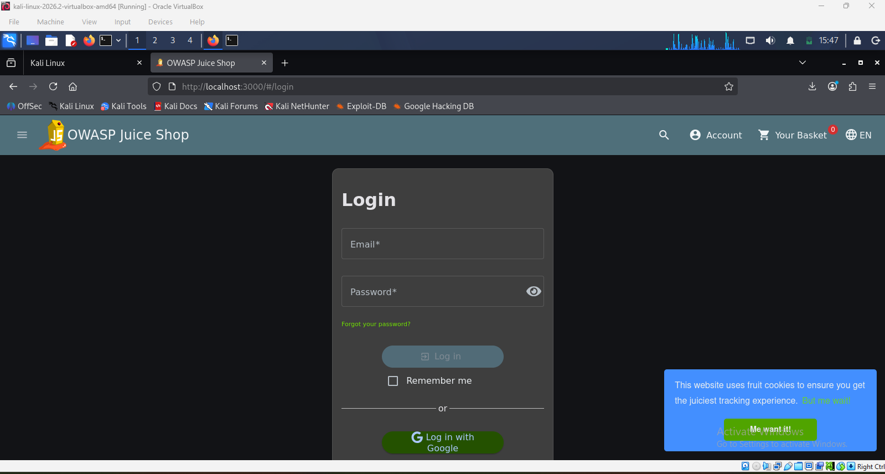
Web Application & Route Discovery
Public pages
Authentication
Main catalog (/#/search)
Customer Feedback
About Us
Login (/#/login)
Registration (/#/register)
Forgot Password (/#/forgot-password)
User-restricted
Admin functions
User Profile
Shopping Basket (/#/basket)
Order History
Administrative Dashboard (/#/administration), found via frontend JS route inspection
Notes:
Public, authentication, user-restricted and admin routes were identified. The administration route surfaced from inspecting frontend JavaScript routes.

Slide 5
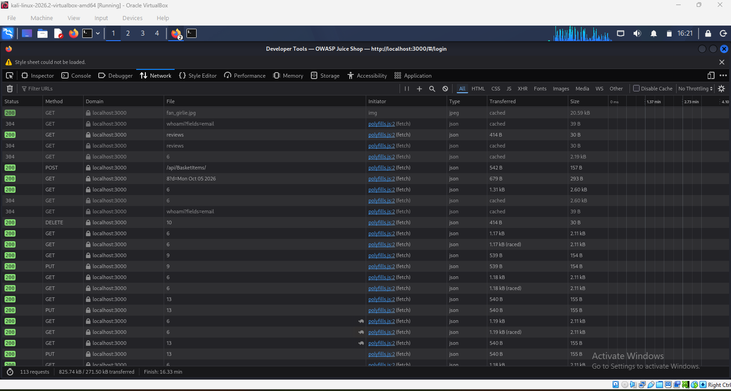
API & Endpoint Mapping
GET
/api/SecurityQuestions/
Fetches registration security questions
POST
/api/Users/
Processes account creation payloads
POST
/api/SecurityAnswers/
Registers account recovery answers
Network tab: HAR capture of API calls
POST
/rest/user/login
Authenticates credentials, returns a JWT
/rest/user/whoami
Checks active token validity
Unauthenticated exposure
The configuration endpoint returns server settings with no login required.
GET
GET
/rest/basket/{id}
Retrieves cart contents by numeric ID
GET
/rest/admin/application-configuration
Exposes server settings without authentication
Notes:
Routes were identified from intercepted traffic captured via HAR. The admin configuration endpoint is notable because it answers without authentication.

Slide 6
Technology Fingerprinting
FRONTEND
BACKEND
DATABASE
AUTH
Angular SPA
Node.js + Express
SQLite
JWT
›
›
›
main.js and runtime.js bundles
Header: X-Powered-By: Express
Accessed through the Sequelize ORM
Bearer tokens on API requests
Confirmed through system inspection, HTTP response headers and source inspection.
Notes:
The full stack: Angular front end, Node/Express back end, SQLite via Sequelize, and JWT bearer authentication.

Slide 7
Attack Surface Inventory
Asset / Endpoint | Type | Access | Technology | Security relevance | Priority
http://localhost:3000/ | Web | Public GET | Angular SPA | Entry point to client bundles and unlinked JS routes | Low
/rest/admin/application-configuration | API | Public GET | Node.js / Express | Data leakage: OAuth parameters, chatbot config and defaults without auth | High
/rest/user/login | API | Public POST | Express / JWT | Primary authentication; password hashes inside returned JWT payload | High
/rest/basket/{id} | API | Authenticated GET | Node.js / Express | IDOR risk: sequential integer IDs enable object tampering | High
/api/Users/ | API | Public POST | Express / SQLite | Registration vector for SQL injection or BOLA during user creation | Medium
/api/SecurityQuestions/ | API | Public GET | Express / SQLite | Enumeration vector for security questions | Low
Notes:
Six assets, three rated High: the unauthenticated configuration endpoint, the login/JWT handling, and the basket endpoint with sequential IDs.

Slide 8
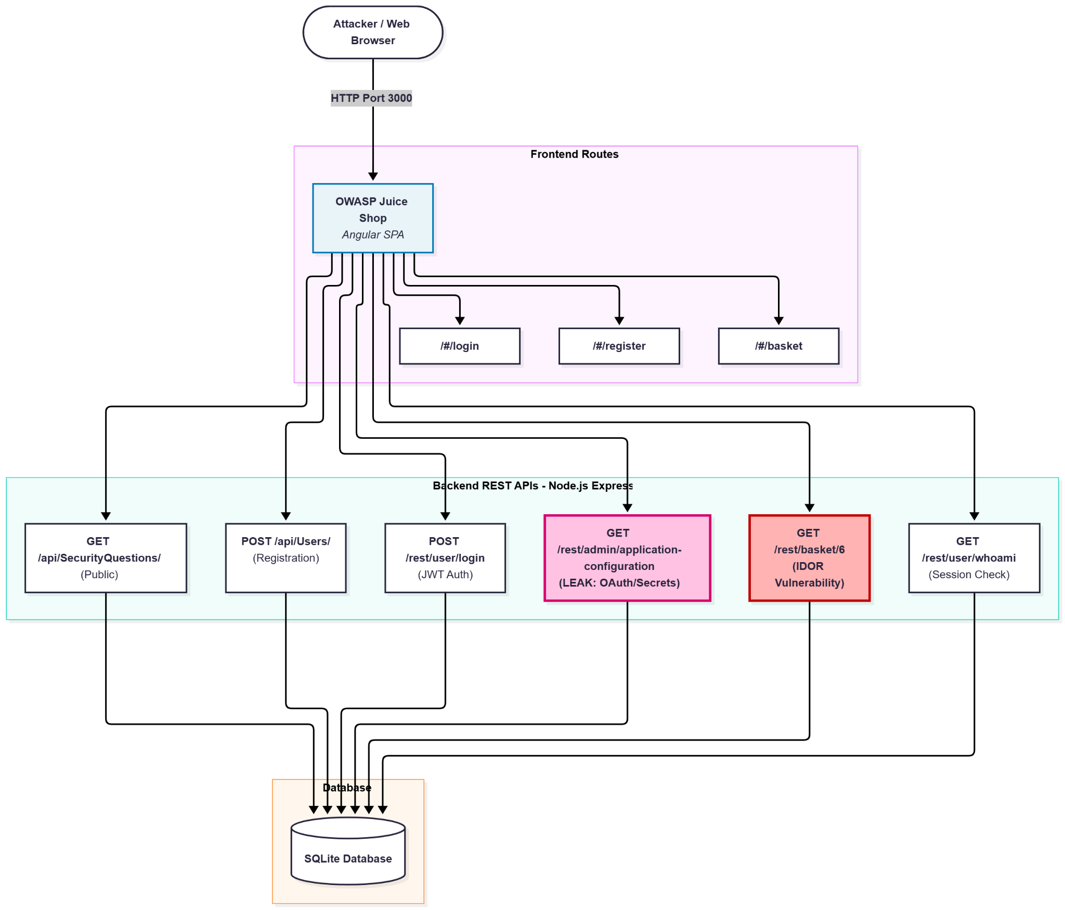
Attack Surface Diagram
Browser to SPA
Traffic enters on port 3000 and hits Angular routes, then Express REST APIs, then SQLite.
Config leak
Unauthenticated configuration disclosure, shown in pink.
IDOR
Basket endpoint with sequential IDs, shown in red.
Notes:
The diagram traces client traffic through the Angular routes to the Express REST APIs and SQLite. High-priority exposure points are highlighted in pink and red.

Slide 9
Prioritized Testing Plan
HIGH PRIORITY
MEDIUM PRIORITY
LOW PRIORITY
1. Unauthenticated config access
/rest/admin/application-configuration
Exposes internal routes, credentials and system settings without auth.
2. IDOR in basket operations
/rest/basket/{id}
Sequential IDs let attackers read or modify other users' carts.
3. Authentication & JWT security
/rest/user/login
Inspect JWT claims for over-disclosure (password hashes) and weak signature checks.
User registration & input fields
/api/Users/
Check input sanitization, SQL/NoSQL injection and mass assignment.
Public static endpoints
/api/SecurityQuestions/
Low impact; mostly static informational data.
Notes:
Testing order follows risk: configuration access first, then basket IDOR, then JWT handling, then registration input handling, then the low-impact static endpoints.

Slide 10
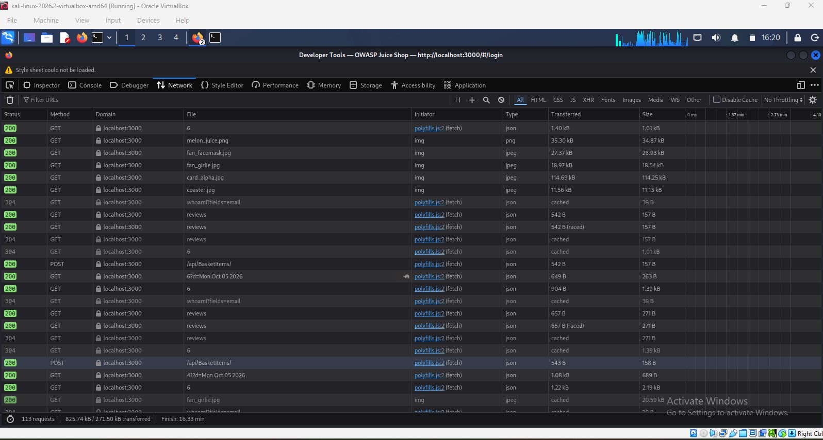
Evidence
Captured artifacts
HAR logs
Network trace of the browsing session
Port scan output
Nmap result confirming the service on port 3000
UI screenshots
Registration, login flow and Developer Tools network logs
Container running on port 3000
Login flow
Network tab: API requests
Developer Tools: JWT response
Notes:
Evidence supporting each section: HAR capture, Nmap output, and UI and Developer Tools screenshots.

Slide 11
Key Takeaways & Next Steps
Open configuration
Predictable object IDs
Token over-disclosure
The admin configuration endpoint answers without authentication.
Sequential basket IDs create an IDOR risk.
JWT payloads from login need a close look for sensitive claims.
Next step
Run follow-up security testing in priority order: configuration access, basket IDOR, JWT security, then registration input handling.
Notes:
Close by restating the three high-priority exposure points and the order for follow-up testing.

